Slide 1



Lab Name: CGM Project ID: 6461 Project Name: Backward compatibility in face recognition
044167 Project A – Final Presentation
Semester: Winter 2021/2022
Lab Manager: Hovav Gazit
Main project supervisor: Elad Hirsch
Presentors: Shai Yehezkel
Lior Dvir

Slide 2
Table of contents
01
03
02
04
Background
Work Done
Project Definition
Further Improvements
05
Conclusions

Slide 3
01
Background

Slide 4
Glossary & Terms
01
Background
Machine Learning
Neural Network
Model Architecture
Feature Vector/Embedding Space
Recognition/Retrieval
Cross model compatibility (CMC)

Slide 5
Glossary & Terms
01
Background
Machine Learning
The study of computer algorithms that can improve automatically through experience and by the use of data.
Data in our scope shall be images.
Supervised learning algorithms are models built on a set of data that contains both inputs and desired outputs.
Neural Network
Feature Vector/Embedding Space
Model Architecture
Recognition/Retrieval
Cross model compatibility (CMC)

Slide 6
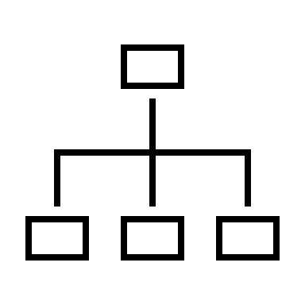
Glossary & Terms
01
Background
Neural Network
A state-of-the-art parametrized model used in supervised learning. Model’s output may vary and is defined by the architecture.
NN
Machine Learning
Female
Has Glasses
Light ginger hair color
Feature Vector/Embedding Space
Model Architecture
Recognition/Retrieval
Cross model compatibility (CMC)

Slide 7
Glossary & Terms
01
Background
Model Architecture
# of layers, dimensions, optimizers, schedulers, activation functions, loss function, hyper-parameters etc. of the model
Machine Learning
Neural Network
Feature Vector/Embedding Space
Recognition/Retrieval
Cross model compatibility (CMC)

Slide 8
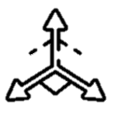

Glossary & Terms
01
Background
Feature Vector/Embedding Space
Embedding Vector - Output of the last layer of the network (W\O Classification).
Embedded Space – The space spanned by the embedded vectors.
NN
Embedding
Vector
Machine Learning
Neural Network
Model Architecture
$$V=(x_{1},x_{2}…x_{512})$$
NN
Recognition/Retrieval
Embedded Space
Cross model compatibility (CMC)

Slide 9
Glossary & Terms
01
Background
Recognition/Retrieval
The process of querying an embeddings gallery.
A vector is associated with a unique person, and thus a recognition process is achieved.
NN
Embedding
Vector
Machine Learning
Alice
Neural Network
Model Architecture
Feature Vector/Embedding Space
Search
(Nearest Neighbor)
Cross model compatibility (CMC)
Person is Alice
Gallery Embeddings

Slide 10
Academic Article Reference:
01
Background
Cross model compatibility (CMC)
Unified Representation Learning for Cross Model Compatibility
Visual recognition and retrieval systems are widely used in out lives.
Frictionless physical access (E.G Apple ID)
Missing person search
Global place recognition
Homeland security applications
Link to article
Chien-Yi Wang et al.

Slide 11
Academic Article Reference:
01
Background
Unified Representation Learning for Cross Model Compatibility
Many recognition and retrieval models are based on Deep Neural Networks (DNN).
A person’s image is fed to the net which outputs an embedding vector.
The embedding vector queries the gallery
Embedded Space #1
NN #1
Search
(Nearest Neighbor)
Link to article
Gallery Embeddings
Chien-Yi Wang et al.

Slide 12
Academic Article Reference:
01
Background
Unified Representation Learning for Cross Model Compatibility
DNN architectures progress fast and create a diverse embedding models.
Embedded Space #1
NN #1
Search
(Nearest Neighbor)
Gallery Embeddings
Embedded Space #2
Link to article
NN #2
Chien-Yi Wang et al.

Slide 13
Academic Article Reference:
01
Background
Unified Representation Learning for Cross Model Compatibility
Addressing the queries in the new architecture w.r.t to the old architecture gallery is what is called the Cross Model Compatibility (CMC)
Embedded Space #1
NN #1
Search
(Nearest Neighbor)
Gallery Embeddings
Embedded Space #2
Link to article
NN #2
Chien-Yi Wang et al.

Slide 14
Naïve Approach
01
Background
Re-encode all gallery images with the new model – Imposes privacy issues
Embedded Space #1
NN #1
Search
(Nearest Neighbor)
Gallery Embeddings #1
Gallery Embeddings #2
NN #2
Embedded Space #2
Search
(Nearest Neighbor)

Slide 15
Previous Work
01
Background
Transform both embedding space and gallery embedding through a unified representation learning framework
NN #1
Embedded Space #1
Gallery Embeddings #1
Gallery Embeddings #2
Search
Search
Embedded Space #2
NN #2
Embedded Space #3
Unified Transformer

Slide 16
Previous Work
01
Background
Transform query embeddings into gallery embedding space.
NN #1
Embedded Space #1
Search
(Nearest Neighbor)
Gallery Embeddings #1
Embedded Space #2
Embedded Space #3
NN #2
Transformer

Slide 17
02
Project Definition

Slide 18
02
Project Definition
Goal
Our goal in this project is to solve the Cross Model Compatibility (CMC) problem by implementing previous work solution and improve it.
NN #1
Embedded Space #1
Search
(Nearest Neighbor)
Gallery Embeddings #1
Embedded Space #2
Embedded Space #3
NN #2
Transformer

Slide 19
02
Project Definition
Goal
Improvement of previous work will be done via Interpolation of Embedded Vectors and adding new Loss Functions
Loss
Loss
Loss

Slide 20
02
Project Definition
Basic Assumptions
All images are of visible faces, centered and aligned
The two existing recognition networks label all images correctly
New network is not limited in number of parameters

Slide 21
02
Project Definition
Identification of Possible difficulties
Adjusting the existing code of InsightFace to our needs
Memory limitations: Image dataset is VERY big
Long training time
Limited time frame of project

Slide 22
02
Project Definition
Tools Needed
Knowledge in Machine Learning (DL specifically)
InsightFace Git repository
Pycharm Pro Edition
Nvidia G-Force GPU
Major Data Software Libraries: Numpy, Torch, Pandas

Slide 23
03
Work Done

Slide 24
Ramp-up
03
Work Done
To get familiar with the topics covered in this project, we went over Stanford University CS231n, Spring 2017.
As a warm-up assignment, we created a linear classifier on CIFAR 10 that achieved ~82% with less than 50k parameters.

Slide 25
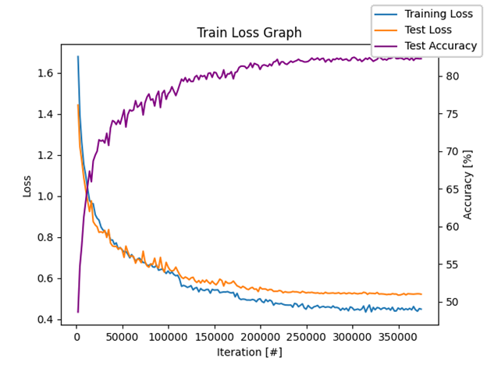
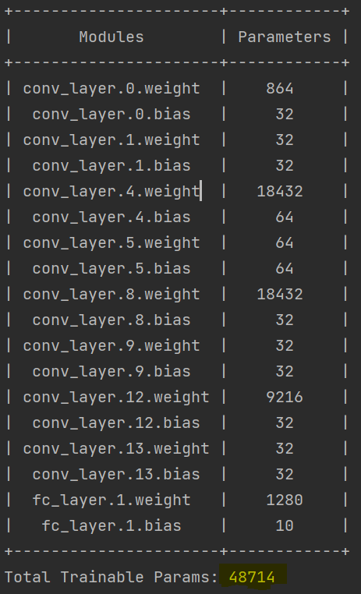
Linear Classifier
03
Work Done
As a warm-up assignment we created a CNN Classifier for the CIFAR-10.
The classifier will serve as a template for the embedding space transformer.
Reached a performance of 82.58% with less than 50K parameters with a simplistic architecture.
60,000 images
32x32x3 Dims
10 classes
6,000 images
per class
CIFAR 10

Slide 26
Linear Classifier
03
Work Done

Slide 27
Train ResNet 18 & ResNet
03
Work Done
Trained two architiectues from the Insight repository.
ResNet 18 Will serve as the legacy model
ResNet 50 Will serve as the improved model
5.6M
ResNet50
ResNet18

Slide 28
New dataset creation
03
Work Done
Take the entire dataset and create a new dataset of embedding vectors.
5.6M
ResNet50
Embedded Space #1
*.pkl
Embedded Space #2
*.pkl
ResNet18
Notes:
Difficulties designing the new dataset - limited memory issues

Slide 29
New dataset creation
03
Work Done
First attempt: Pandas Data Frame
Not enough memory!
Notes:
Difficulties designing the new dataset - limited memory issues

Slide 30

New dataset creation
03
Work Done
Second attempt: PICKLE Data
Works! (but not very convenient)
Notes:
Difficulties designing the new dataset - limited memory issues

Slide 31
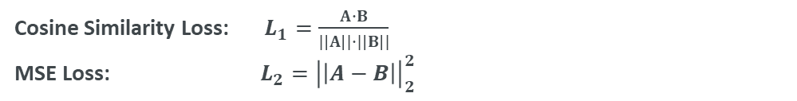

Training Process
03
Work Done
Cosine Similarity Loss: $L_{1}=\frac{A∙B}{|\left|A\right||∙|\left|B\right||}$
MSE Loss: $L_{2}={\left|\left|A−B\right|\right|}_{2}^{2}$
` $A,B∈ℝ^{512}$
ResNet50
Embedded Space #1
$$L_{total}=αL_{1}+βL_{2}$$
$$A$$
Cosine
MSE
$$B$$
Embedded Space #2
Embedded Space #3
ResNet18
Transformer
Notes:
Here talk about balancing issues of using two loss functions

Slide 32

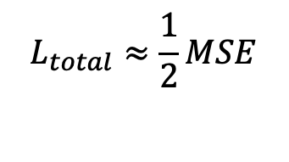
Training Process
03
Work Done
Naïve approach:
$$L_{total}=\frac{1}{2}MSE+\frac{1}{2}COSINE$$
$$L_{total}≈\frac{1}{2}MSE$$
Problem:
Notes:
Here talk about balancing issues of using two loss functions

Slide 33
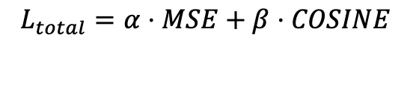

Training Process
03
Work Done
Solution:
$$L_{total}=α⋅MSE+β⋅COSINE$$
Where:
$$α≪β$$
Notes:
Here talk about balancing issues of using two loss functions

Slide 34
Transformer Architecture
03
Work Done
1. MLP
Transformer
Single FC layer

Slide 35
Transformer Architecture
03
Work Done
Transformer
2. MSResNet
Multi-Scale ResNet
Residual 3x3 Conv Blocks
Conv 7x7
BN
ReLU
Max Pooling
Residual 5x5 Conv Blocks
Residual 7x7 Conv Blocks

Slide 36
Using Interpolation of Embeddings
03
Work Done
We created new interpolation of Embedded Vectors in train set space.
Transformer
Training Set Embedded Space
Output Embedded Space
Notes:
Here talk about the idea behind interpolation
Including the relative distance being preserved

Slide 37
Using Interpolation of Embeddings
03
Work Done
First attempt: Linear combination
Label 0
Label 1
Label 2
Label 3

Slide 38
Using Interpolation of Embeddings
03
Work Done
Second attempt: By size combination
Label 2
Label 1
Label 0
Label 3

Slide 39
03
Work Done
Evaluating Process
In inference, we calculated accuracy using KNN between transformed vectors and target feature space, and their associated label.
Embedded Space #1
ResNet50
Min Dist.
Output Embedded Space
Embedded Space #2
Embedded Space #3
ResNet18
Transformer

Slide 40
Evaluating Process
03
Work Done
First attempt: KNN with Mean of labels
Min Dist.
Bad results
Output Embedded Space

Slide 41
Evaluating Process
03
Work Done
Second attempt: KNN with all of labels
Min Dist.
Better results!
Output Embedded Space

Slide 42
Results
03
Work Done

Slide 43
Dataloader for .pkl
03
Work Done
Created a new dataloader class that will handle dumped .pkl files that serves as a dataset.
Dataloader
*.pkl
Batches of embedding vectors

Slide 44
04
Further Improvements

Slide 45
04
Further Improvements
Improvements
Improve *.pkl dataset infrastructure and data structure
Try various architectures for the transformer
Improve interpolation method
Different accuracy evaluation
Try different datasets

Slide 46
04
Further Improvements
Improvements
Dataset infrastructure and data structure
*.pkl

Slide 47
04
Further Improvements
Improvements
MLP
ResNet
More architectures
???

Slide 48
04
Further Improvements
Improvements
Improve interpolation method

Slide 49
04
Further Improvements
Improvements
Try different datasets

Slide 50
04
Further Improvements
Time Assessment
Task | Assessed Date
Extract Embedded Vectors | 01/12/21
DataLoader | 07/12/21
Identity Network | 14/12/21
Train Network | 21/12/21
More Loss & Reg | 05/01/22 – 01/03/22
Interpolate Vectors | 05/01/22 – 01/04/22

Slide 51
05
Conclusions

Slide 52
05
Conclusions
Conclusions
Loss
When multiple losses are used:
Balancing!
Loss
Loss

Slide 53
05
Conclusions
Conclusions
Datasets are
hard
*.pkl

Slide 54
05
Conclusions
Conclusions
Deeper is not always
better

Slide 55
05
Conclusions
Conclusions
Synth. data works when used
correctly

Slide 56
04
Future Work
Sanity Check
To make sure the DataLoader works we produced an Identity Topo. And received (as expected) a loss of 0.
Identity Topo.
Cosine Loss
MSE Loss

Slide 57
04
Future Work
Training our new third topology
We trained the new topology using the Feature Tensors extracted from RN50 as the train set and the Feature Tensors extracted from RN18 as the ground truth.
New Topo.
Loss

Slide 58
04
Future Work
Using Interpolation of Embeddings
In inference, we calculated accuracy using KNN between transformed vectors and target feature space
Min Dist.
Output Embedded Space

Slide 59
Thank You!
Dog 99.99%

